Slide 1


DESIGN OF AN VFD MOTOR CONTROL PANEL
USING EPLAN ELECTRIC P8
Department of Electrical & Electronics Engineering
Batch Code: EEK6252611
FINAL REVIEW
10/04/2026
Project Associates:
K.Divya (22K61A0247)
G.Sowmya (22K61A0240)
CH.Suvarna (22K61A0222)
B.Vasavi (22K61A0218)
Under the Guidance of
Mr.A.S.N.R.Gopal
Assistant Professor

Slide 2

Content:
Title of the project
Aim of the project
Objectives
Literature survey
Proposal abstract
Block diagram
Power circuit
Control circuit
Over view of 2D panel layout
Characteristics of VFD
Advantages
References
Conclusion

Slide 3

Title of the project
DESIGN AND DOCUMENTATION OF AN VFD MOTOR CONTROL PANEL USING EPLAN ELECTRIC P8

Slide 4
Aim of the project:-
The aim of this project is to design a complete Variable frequency drive (VFD) based motor control panel using EPLAN Electric P8.
Ensuring safe ,efficient ,and reliable motor operation while complying with relevant industrial standards.
The project focuses on developing a electrical schematic and documentation and reporting features of EPLAN Electric P8.
This design approach helps improve Engineering accuracy and provide industry- ready documentation suitable for panel fabrication ,installation and maintenance.

Slide 5
Objectives:
Control motor speed by varying frequency and voltage through the VFD.
Utilize VFD torque-boost and vector-control features for smooth torque delivery.
Include circuit breakers, overload relays, fuses, and E-stop circuits.
Implement Start, Stop, Forward, Reverse, and Local/Remote selection in the control logic.
Electrical and logical interlocks to prevent wrong operations or simultaneous commands.
Provide PLC/DCS interface through digital/analog I/O and communication protocols (Modbus, Profibus, Ethernet/IP, etc.)

Slide 6
Literature Survey:-
Conventional motor control methods such as DOL and star–delta starters are simple but cause high starting current, mechanical stress, and poor energy efficiency.
Literature shows that Variable Frequency Drives (VFDs) provide effective speed and torque control with reduced energy consumption and improved motor performance.
Studies emphasize the need for proper panel design, safety protection, and compliance with IEC standards for reliable industrial operation.
Existing research mainly focuses on theoretical aspects, with limited work on practical VFD motor control panel design using EPLAN Electric P8.

Slide 7
Proposal Abstract:-
Design of an induction motor control circuit using a VFD
Circuit developed using EPLAN software
Accurate control of motor speed and torque
High efficiency and safe operation
Includes protection and interlocking systems
Terminal layouts and bill of materials provided

Slide 8
Block diagram:
MOTOR
ELECTRICAL
POWER INPUT
POWER ELECTRONIC CONVERTER
LOAD
FEEDBACK
ELECTRICAL MACHINE
CONTROLLER
ELECTRICAL DRIVE

Slide 9
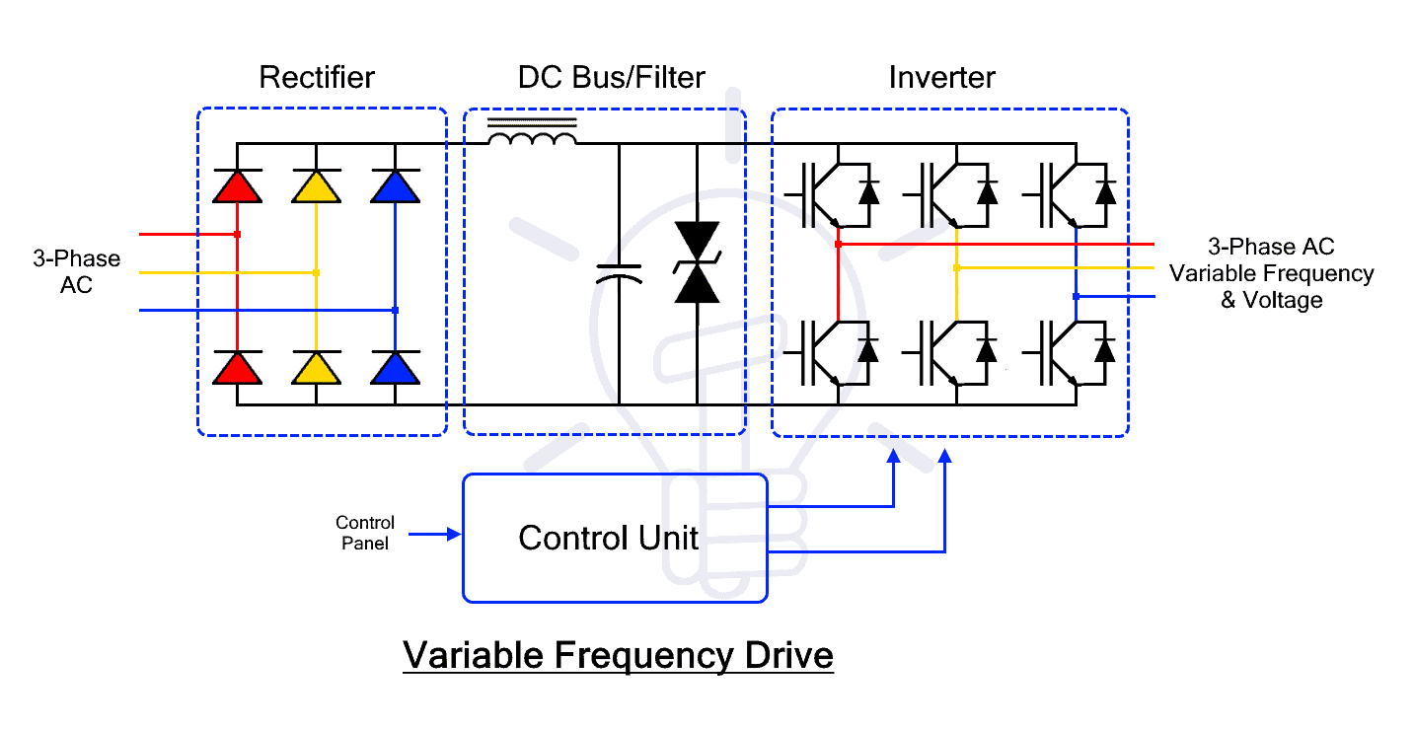
Circuit Diagram :-

Slide 10
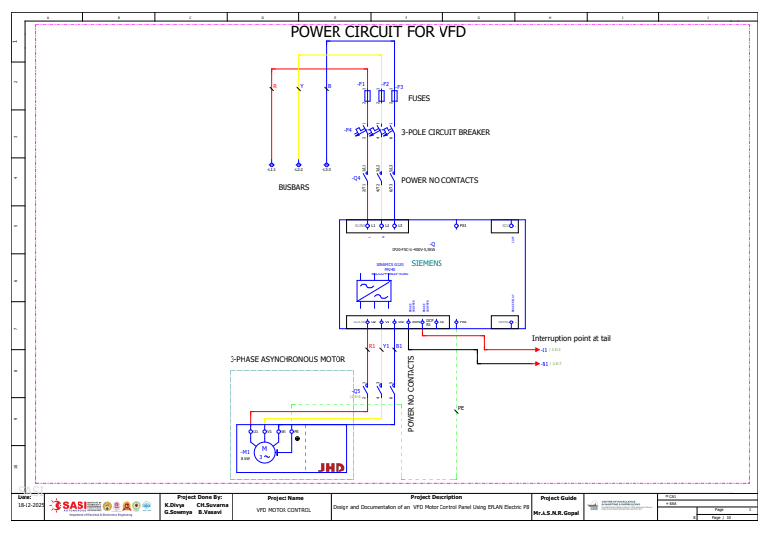
Power Circuit for VFD :-
Incoming 3-phase supply (R-Y-B) is fed to the panel through busbars.
Fuses and 3-pole circuit breaker provide short-circuit and overload protection.
Input contactor (NO contacts) controls ON/OFF power supply to the VFD.
VFD converts fixed AC to variable voltage and frequency to control motor speed.

Slide 11
VFD output (U-V-W) supplies controlled power to the 3-phase induction motor.
Motor speed varies with output frequency of the VFD.
Earthing (PE) ensures safety and reduces electrical noise.

Slide 12
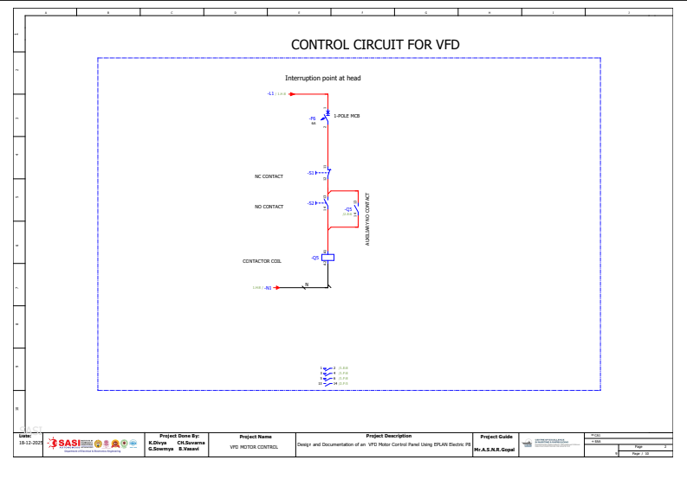
Control Circuit for VFD:-
Control supply enters through MCB for protection.
NC STOP push button provides emergency stopping.
NO START push button energizes the contactor coil.
Auxiliary NO contact provides self-holding (latching) of the contactor.
Contactor coil enables power supply to vfd

Slide 13
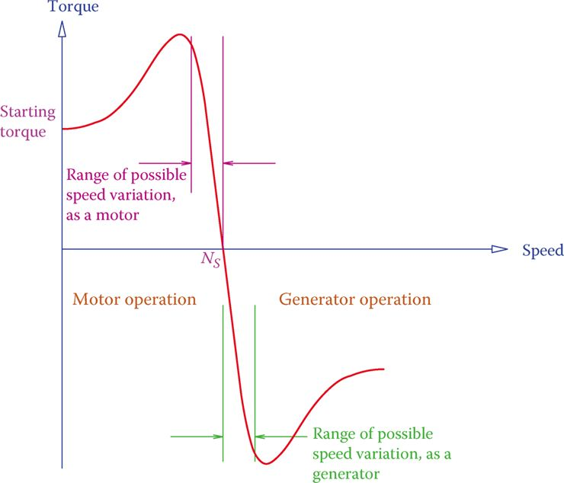
CHARACTERISTICS OF VFD
Starting torque is developed at zero speed when the motor starts.
Torque increases with speed and reaches maximum (breakdown torque).
Normal motor operation occurs below synchronous speed (Ns).
At synchronous speed (Ns), torque becomes zero.

Slide 14
Above Ns, motor operates in generator mode.
Motor region is used for driving loads.
Generator region enables regenerative braking.
Speed variation range depends on load and supply conditions

Slide 15
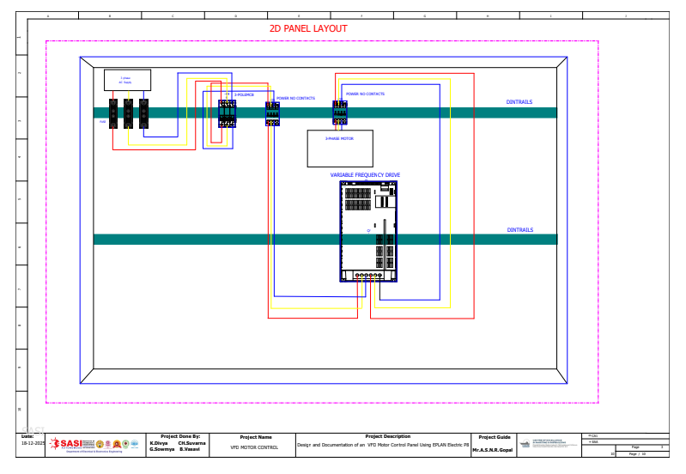
Overview of 2D panel layout:-
Panel layout shows physical arrangement of all components inside the control panel.
Provides clear visualization of component placement inside the panel
Reduces wiring errors during panel fabrication.
Makes troubleshooting faster by easy component identification.
Useful for documentation and approval before manufacturing.
Saves time and cost during panel assembly.

Slide 16
Advantages:
Enables structured and standardized design of VFD motor control panels.
Ensures high accuracy and consistency in electrical schematics.
Minimizes design and wiring errors through automated functions.
Reduces overall engineering and documentation time.
Allows easy development of power, control, and safety circuits.
Automatically generates terminal layouts and wiring diagrams.
Provides an accurate and detailed bill of materials (BOM).
Improves coordination between design, installation, and maintenance teams.
Enhances troubleshooting through clear and well-organized documentation.

Slide 17
References:-
1. Gischel, B., EPLAN Electric P8 Reference Handbook, Carl Hanser Verlag,
Germany, 2014.
2. Campbell, S. J., Solid-State AC Motor Controls, Marcel Dekker Inc., New York,
1989.
3. Siskind, C. S., Electrical Control Systems in Industry, McGraw-Hill Education,
2001.
4. Bose, B. K., Modern Power Electronics and AC Drives, Prentice Hall, 2002.
5. Rashid, M. H., Power Electronics: Circuits, Devices, and Applications, Pearson
Education, 2014.
6. ABB Group, Technical Guide No. 4 – Guide to Variable Speed Drives, ABB
Publication, 2011.
7. Siemens AG, SINAMICS Low Voltage Drives System Manual, Siemens Industry,
2018.

Slide 18
Conclusion:
The design of a VFD motor control panel using EPLAN Electric P8 provides an efficient and reliable solution for induction motor control. The integration of VFD technology ensures accurate speed and torque control with improved energy efficiency and safe operation. EPLAN Electric P8 enables standardized and precise electrical documentation, including schematics, terminal layouts, and bill of materials. This reduces design errors and engineering time while simplifying modifications. Clear documentation also improves installation, troubleshooting, and maintenance.

Slide 19

Any queries?

